Slide 1
Serverless AI Chatbot for Cloud Cost Optimization Using AWS SageMaker
Team Members:
Sumedh Ambapkar – suambapk@iu.edu
Arju Singh - singarju@iu.edu
Aryan Agrawal - aryagraw@iu.edu
Krishna Prasad Subramani - krsubram@iu.edu
Cloud Compute Project : Spring 2025

Slide 2
Agenda
Objective
Proposed Solution
Architectural Design
Demo
System Design
Result
Project Outcome

Slide 3
Objective
Cloud resource management is increasingly complex due to rapidly fluctuating workloads, leading to over-provisioned or underutilized AWS services.
Organizations face critical challenges such as:
Lack of real-time visibility into underutilized resources (EC2, Lambda, S3)
Difficulty in generating accurate, timely rightsizing recommendations
Manual analysis of AWS Cost Explorer and CloudWatch is slow and error-prone
Static recommendations that fail to adapt to changing usage patterns
These issues often result in delayed optimization, increased costs, and inefficient resource management.

Slide 4
Proposed Solution
To solve these challenges, we propose a Machine Learning Solution which look into Historical data & Usage and would recommend the appropriate sizing.
Uses Amazon Lex for natural language processing (NLP), This allows end user to query the tool and get feedback on questions asked.
Leverages AWS SageMaker for predictive analytics and smart recommendations. Sagemaker is responsible deploying endpoints to execute ML models
Automates data ingestion ,retrieval, analysis, and suggest rightsizing
Provides real-time, conversational cost insights
Continuously improves using historical data for adaptive optimization
This solution empowers organizations to optimize AWS usage, reduce operational expenses, and make data-driven decisions—all through a simple chat interface.

Slide 5
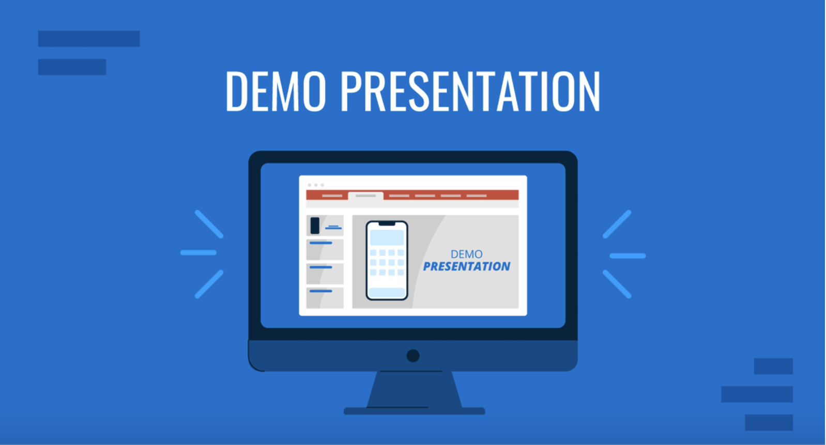
Re

Slide 6
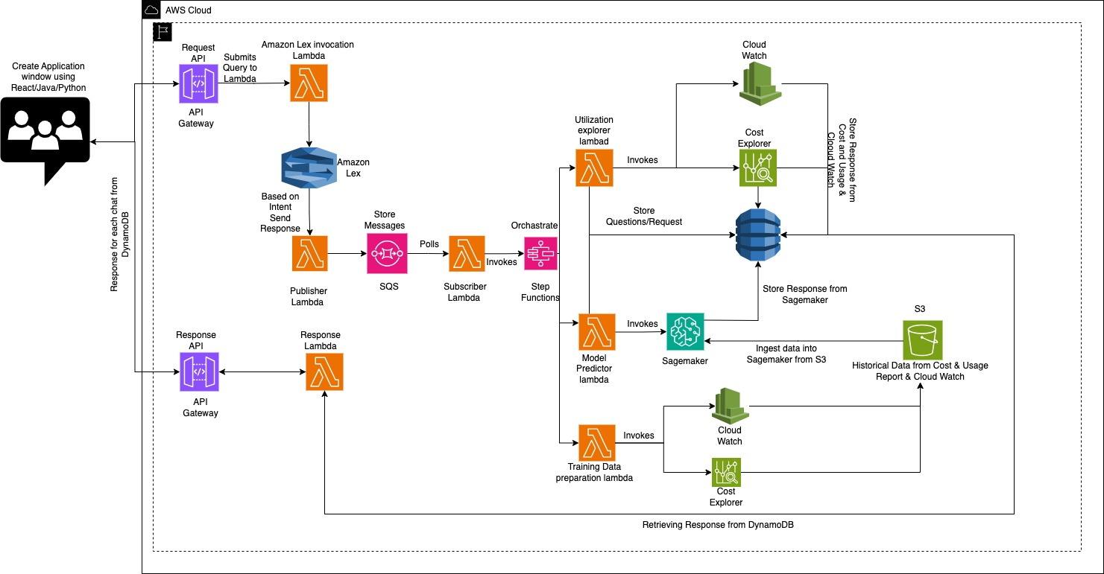
Architectural Flow

Slide 7
System Design
The chatbot system follows an event-driven, serverless architecture using AWS services for scalability, low latency, and asynchronous processing.
1. User Interaction (React Frontend)
A React application enables seamless interaction with the chatbot.
Communicates through Amazon API Gateway.
Session ID used for tracking conversations and responses.
2. Amazon API Gateway (Secure Ingress Point)
Front-door for all chatbot traffic.
Handles authentication, throttling, and request routing.
Ensures secure and scalable request flow.
3. ApiToLexHandler (AWS Lambda Function)
Preprocessing Layer: Cleans and formats incoming queries.
Converts user messages into a structured format.
Forwards requests to Amazon Lex for natural language understanding (NLU).

Slide 8
4. Amazon Lex (NLP Engine)
Interprets user queries based on defined intents:
CheckAWSUsage: Extracts serviceName, fromDate, and toDate.
CheckInstanceSize: Extracts instanceId.
Triggers the next processing stage by invoking a second Lambda function.
5. LexToSQSHandler (AWS Lambda Function)
Regex Parsing: Extracts required parameters from Lex output.
Session Management: Maintains unique Session IDs for each interaction.
Parallel Processing Support: Ensures requests are processed asynchronously without conflicts.
Message Dispatch:
Sends structured payloads to Amazon SQS queues for:
Service Usage Analysis (e.g., EC2, S3, Lambda).
Instance Size Evaluation.
6. Amazon SQS (Queueing Layer)
Decouples request processing for high resilience.
Enables asynchronous handling and scales automatically with load.
Efficient queueing for managing multiple simultaneous user queries.

Slide 9
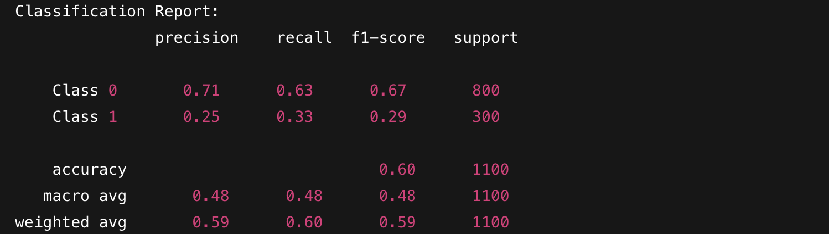
7. Amazon Step Functions (Orchestration Layer)
Deployed to manage multiple concurrent requests efficiently.
Creates a Step Chart to coordinate execution of multiple Lambda functions in parallel.
Accelerates processing and ensures faster response times for users.
8. Amazon SageMaker (ML Intelligence Layer)
Core engine for resource rightsizing recommendations.
RandomForestClassifier model used to classify the optimal instance sizing based on usage patterns.
Performance Evaluation Metrics:
F1 Score
Precision Score
Recall Score
Accuracy Score
Ensures high model reliability and actionable insights.

Slide 10
9. StepFunctionToCloudWatch&CostExplorer(Lambda Function)
Parses user intent and extracts serviceName, fromDate, toDate
Retrieves usage data from CloudWatch
Fetches cost data from AWS Cost Explorer
Formats and sends the result for storage
10. DynamoDB
Stores processed query data and recommendations
Maintains conversation history and usage trends
Enables quick retrieval for future queries and ML model refinement

Slide 11
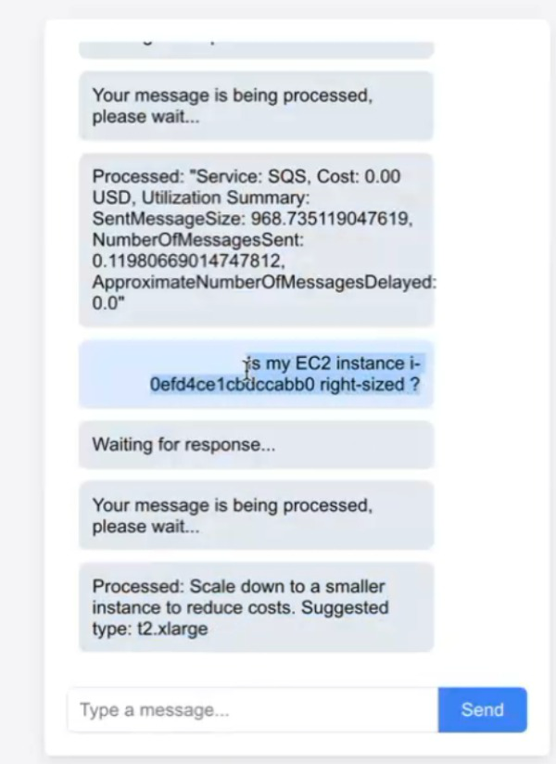
User interaction with Chatbot

Slide 12
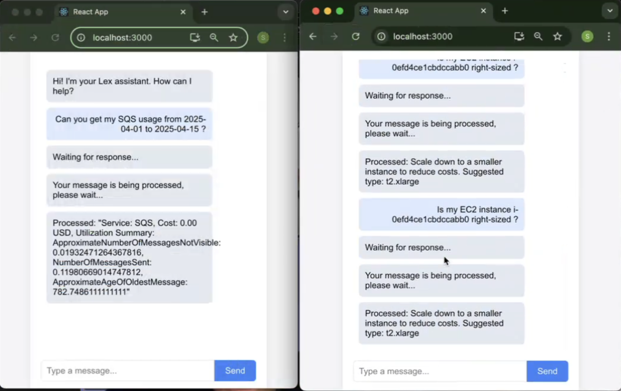
Parallel Sessions & Message Handling

Slide 13
Project Outcome
Intelligent Resource Rightsizing: Reduced over-provisioning and lower AWS costs.
Real-Time Conversational Insights : Faster decision-making and better cost visibility for users.
Fully Serverless and Event-Driven Architecture: High scalability, low maintenance overhead, and pay-per-use cost efficiency
Asynchronous and Parallel Processing : Faster response times and improved system reliability even under heavy load.
Adaptive Machine Learning with Continuous Improvement: Smarter recommendations and continuous optimization without manual intervention.

Slide 14
Challanges
As there were not many resources in AWS , We facing issue to train the data and need to generate Dummy data.
Training model took lot of amount time which crashed system multiple time.
SageMaker deployment crashed due to spot instance were not present for training the model.
Managing Sessions for responses was again challenge on REACT application.

Slide 15
Q & A

Slide 16
Thank you

